Slide 1

PROJECT - 01 Priyanshu Singh Autonomous Street Light System

Slide 2

IDEA AND APPROACH
IDEA
The key elements of an autonomous street light system are :
A sensor to detect light
A sensor to detect motion
A microcontroller
A light emitter
APPROACH
A LDR LM393 Module with adjustable light sensitivity is perfect for the job.
A PIR (passive infrared) Sensor with its wide FOV is excellent for the job.
Arduino Nano is quite sufficient for the job.
Simple 5mm White LED works well and can be replaced by 5v Relay to control light of higher power.

Slide 3
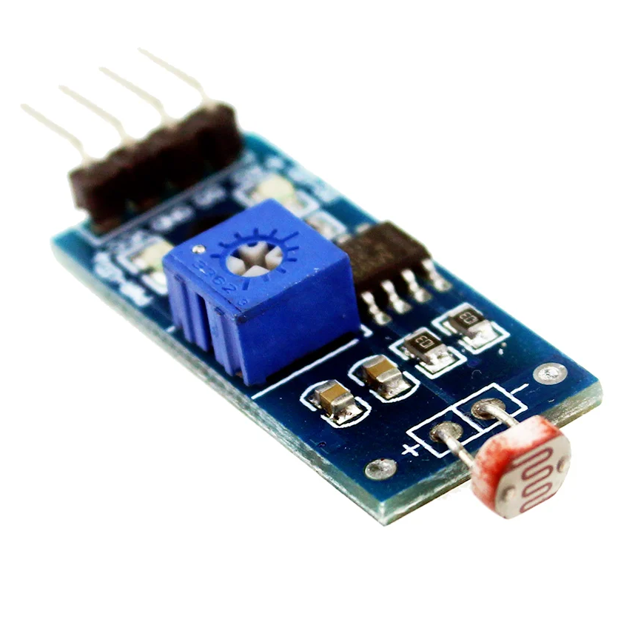
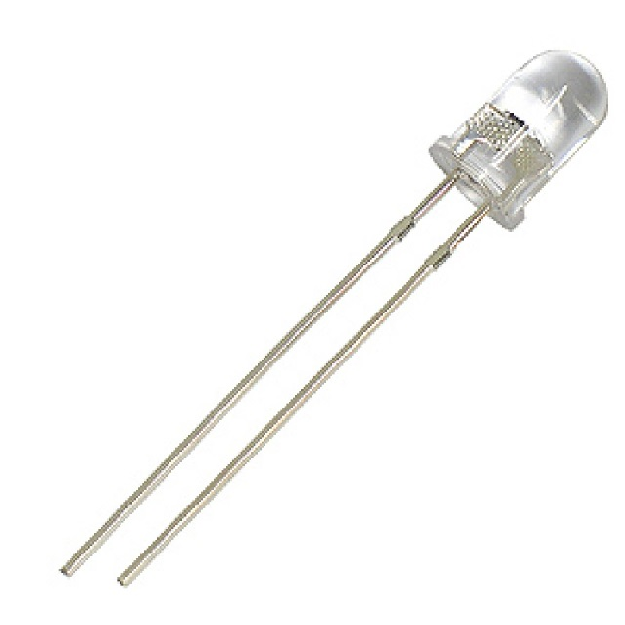
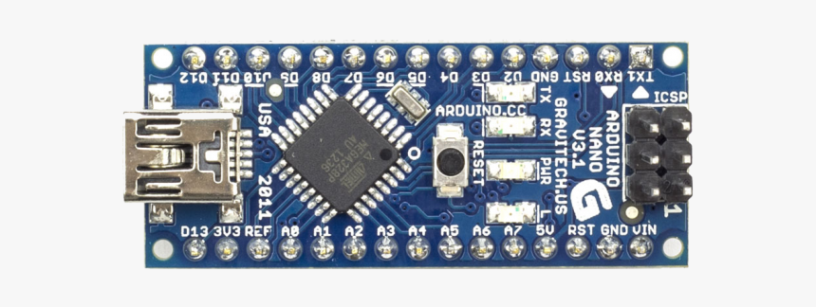
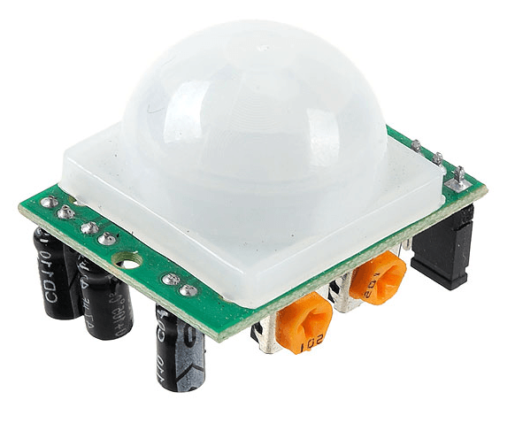
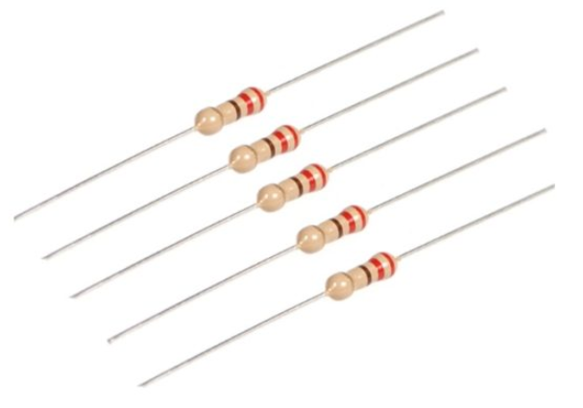
COMPONENTS REQUIRED
LDR LM393 Module
5 Piece
White LED
2Piece PIR
Sensor
5 Piece
220Ω
Resistor

Slide 4
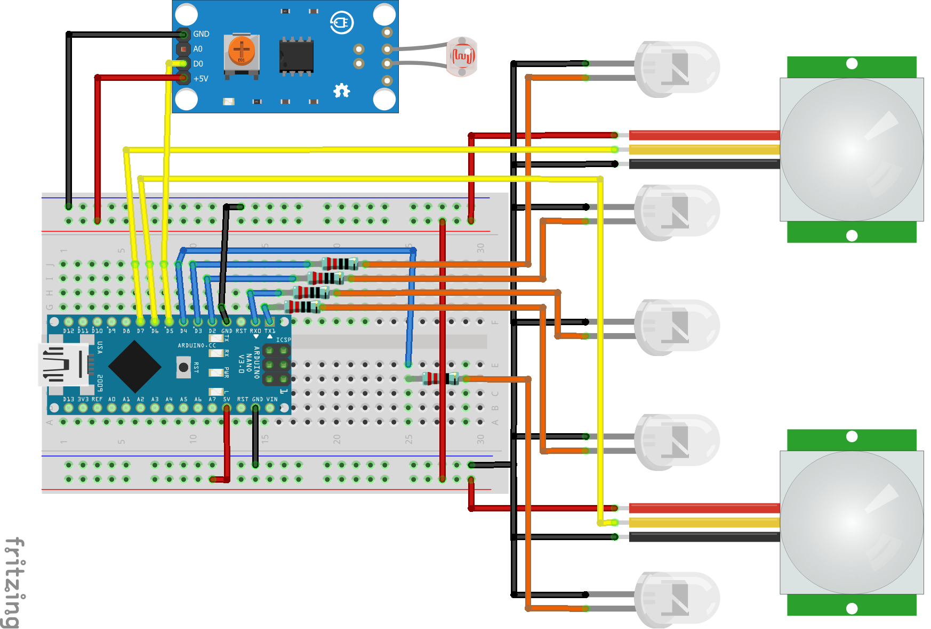
CONNECTION

Slide 5
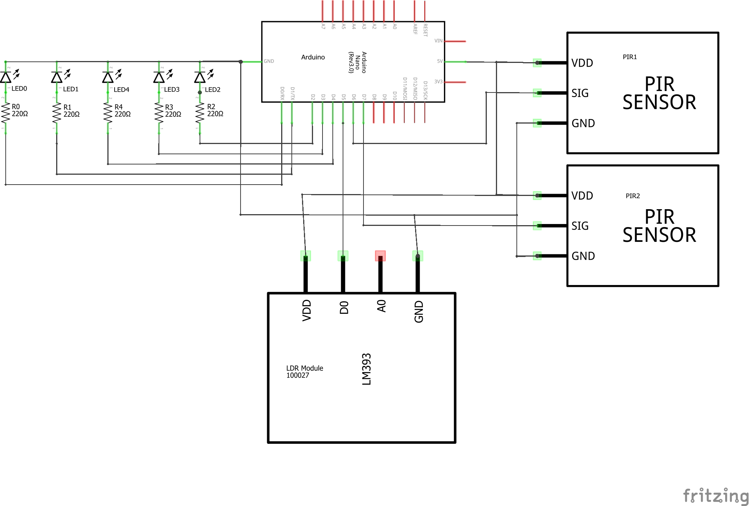
CIRCUIT DIAGRAM

Slide 6

ARDUINO CODE
int LED0=0;
int LED1=1;
int LED2=2;
int LED3=3;
int LED4=4;
int PIR1=6;
int PIR2=7;
int LDR=5;
void setup()
{
Serial.begin(9600);
pinMode( LED0, OUTPUT );
pinMode( LED1, OUTPUT );
pinMode( LED2, OUTPUT );
pinMode( LED3, OUTPUT );
pinMode( LED4, OUTPUT );
pinMode( PIR1, INPUT );
pinMode( PIR2, INPUT );
pinMode( LDR, INPUT );
}

Slide 7
void loop()
{
if (( digitalRead(LDR) == LOW )&& ( digitalRead(PIR1) == HIGH ))
{
digitalWrite (LED0,HIGH);
digitalWrite (LED1,HIGH);
}
else
{
digitalWrite (LED0,LOW);
digitalWrite (LED1,LOW);
}
if (( digitalRead(LDR) == LOW )&& ( digitalRead(PIR2) == HIGH ))
{
digitalWrite (LED3,HIGH);
digitalWrite (LED4,HIGH);
}
else
{
digitalWrite (LED3,LOW);
digitalWrite (LED4,LOW);
}

Slide 8
if (( digitalRead(LDR) == LOW ) && (( digitalRead(PIR1) == HIGH ) || (digitalRead(PIR2) == HIGH)))
{
digitalWrite (LED2,HIGH);
}
else
{
digitalWrite (LED2,LOW);
}
}

Slide 9
TAKEAWAY AND RESOURCES
The above project gave me insight of arduino connections and basics of arduino programing .
I also gained knowledge about the wide variety of sensors available.
The above project is quite modular and can be improved by adding more sensors and lights.
The scalability is also pretty good.
Source:
https://forum.arduino.cc/
https://www.youtube.com/user/arduinoteam

Slide 10
Thank You

